Slide 1


Data Cleaning and Analysis for Toronto FC's Possession- Based Strategy
This project enhances Toronto FC's game strategy by identifying key players with high passing accuracy. Data cleaning ensures accurate player selection for a possession-based game plan.

Slide 2






TEAM INTRODUCTION
Mohamed Afthab
Venkata Manish
Chibuike Okoroama
Prescila Mora

Slide 3


Data Cleaning Process
1
Data Import
Loading datasets from various sources.
2
Data Validation
Checking for data consistency and completeness.
3
Cleaning and Standardization
Removing duplicates, handling missing values, and
ensuring uniform data formats for reliable analysis.

Slide 4

Techniques for Ensuring Data Accuracy
1
Handling Missing Data
Filling in missing values or removing incomplete entries.
2
Outlier Detection
Identifying and treating outliers to avoid skewed analysis.
3
Normalization
Standardizing data for consistent analysis across metrics.
4
Data Validation Checks
Verifying data accuracy after cleaning.

Slide 5
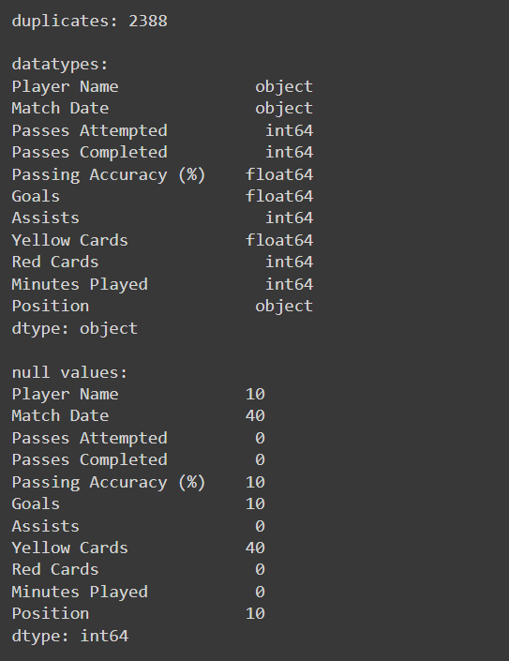
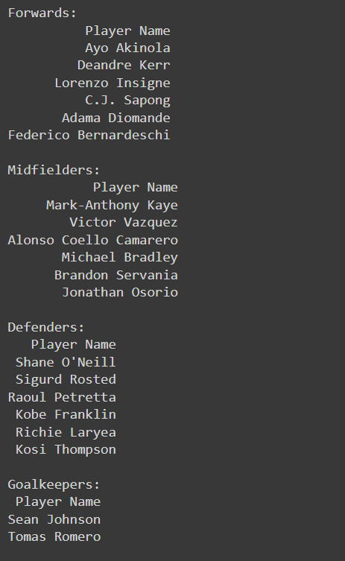
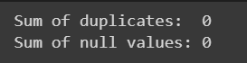
Number of Duplicates and Null values (Before Cleaning)
Players & Position
Number of Duplicates and Null values (After Cleaning)

Slide 6
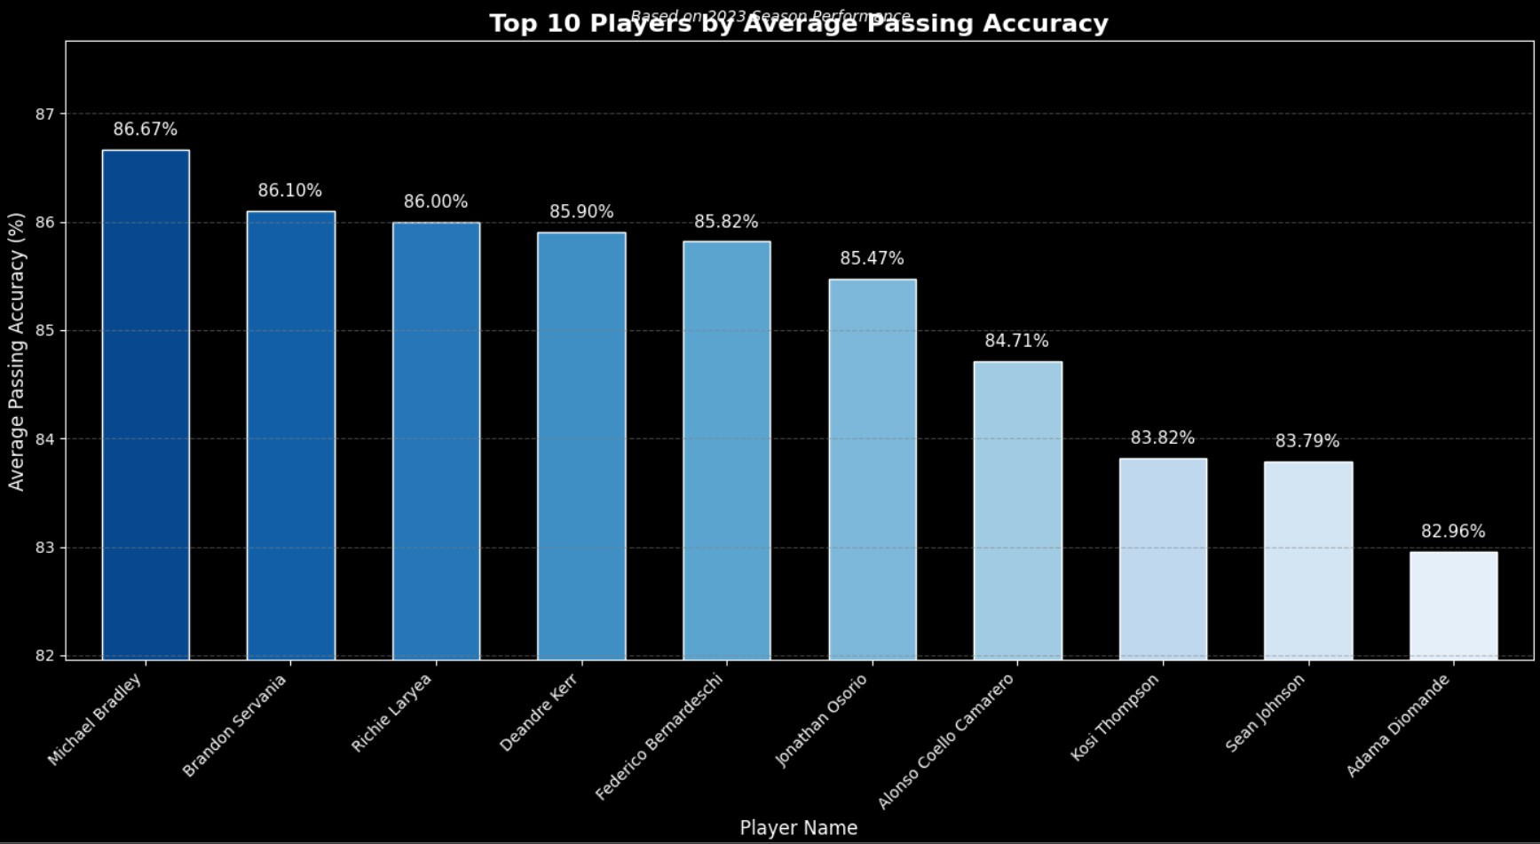

Slide 7
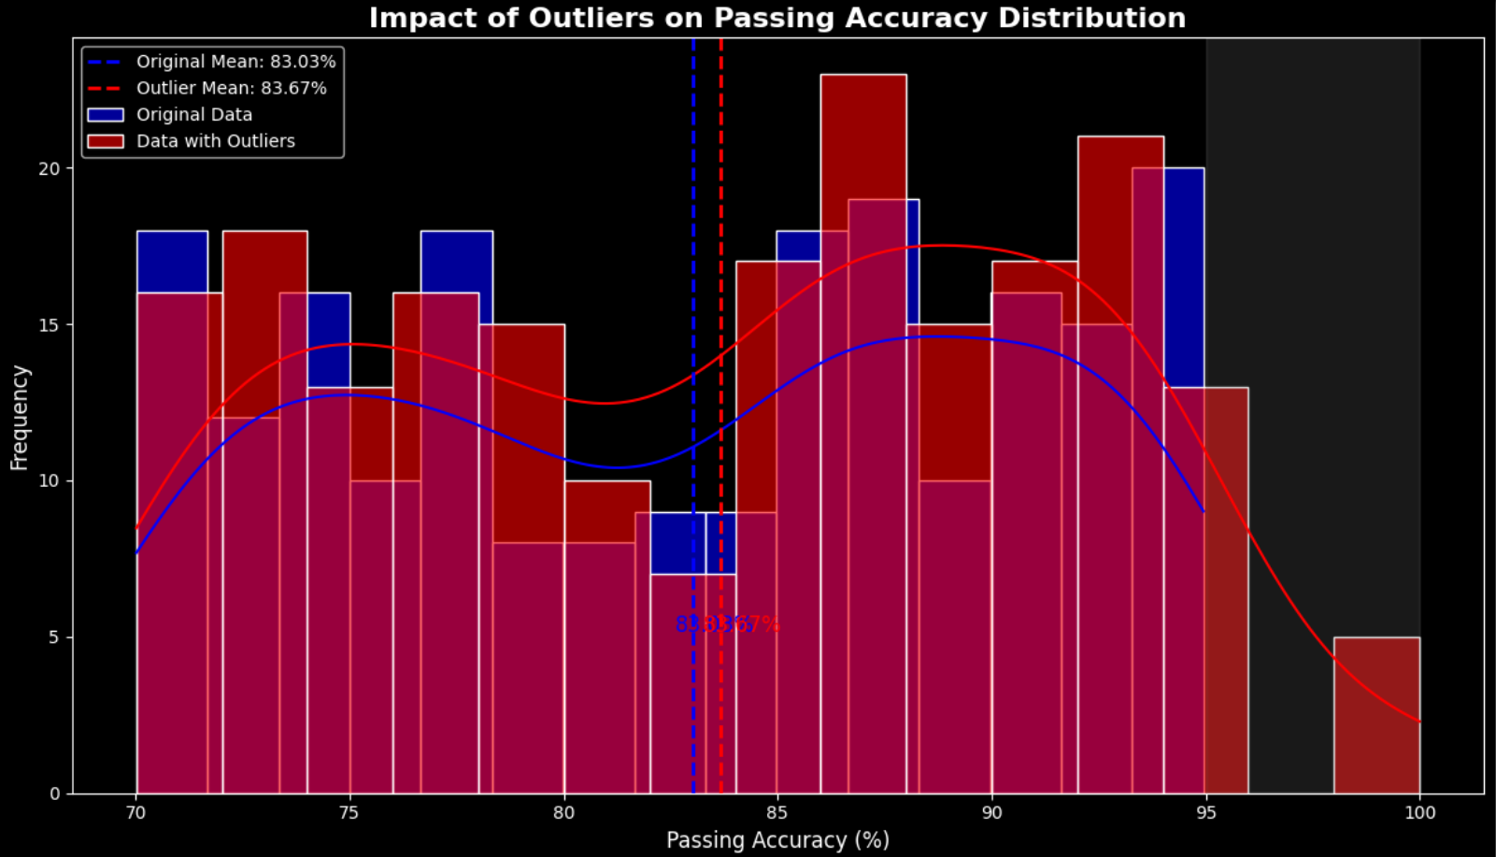

Slide 8
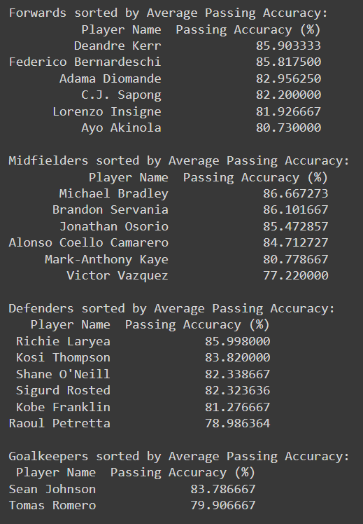
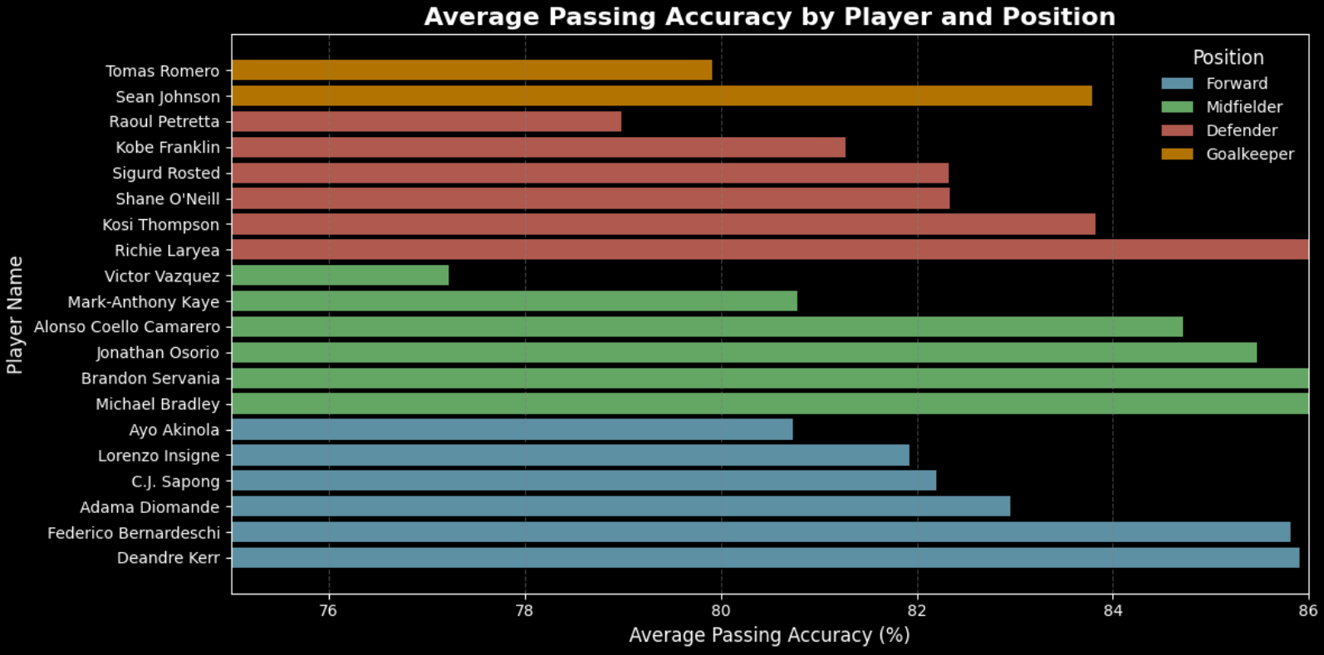

Slide 9


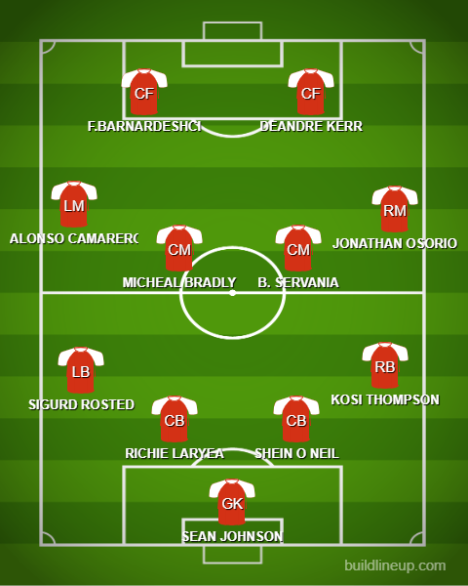
LINE UP BASED ON PASSING ACCURACY

Slide 10
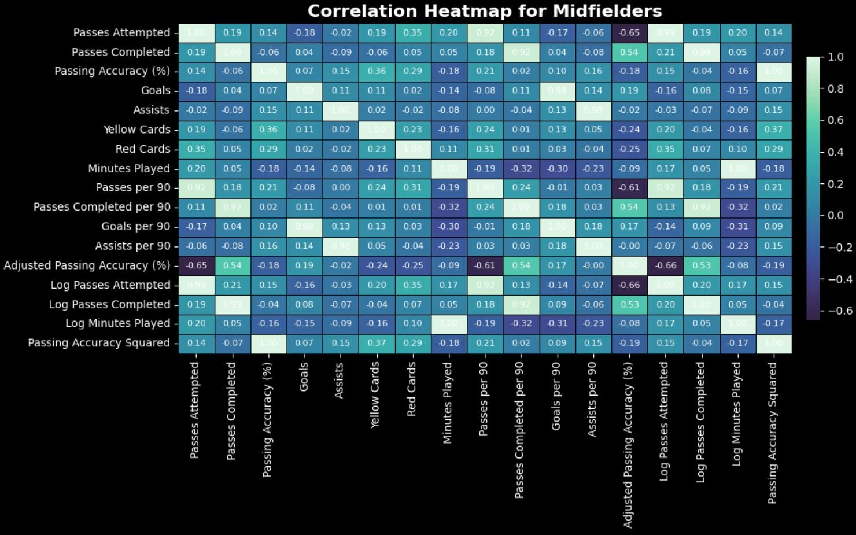
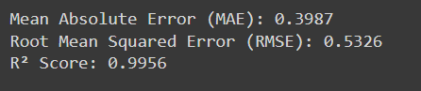

Slide 11
Importance of Data Quality in Decision-Making
Accurate Data
Leads to better analysis of player performance and
more effective game strategies.
Player Selection
Cleaned data ensures coaching staff selects players
who best fit the possession-based strategy.

Slide 12
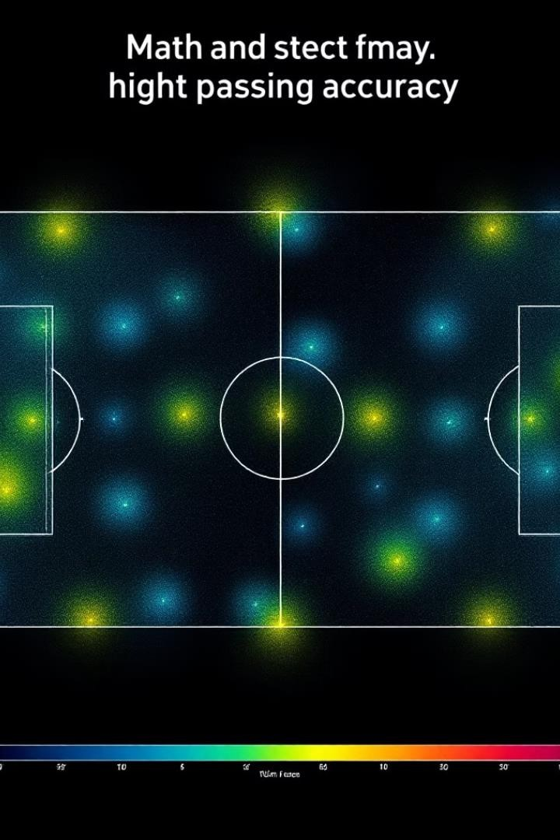
Key Insights and Recommendations
Passing Accuracy
Players with the highest passing accuracy are more consistent in maintaining possession.
Midfielders
Play a critical role in passing dynamics, making data accuracy crucial for this position.

Slide 13


Conclusion
Clean Data
Crucial for informed decisions impacting Toronto FC's performance.
Actionable Insights
Accurate passing data helps select the best players for a possession- based strategy.
Future Analysis
Refining the data pipeline and implementing predictive models for player performance.

Slide 14

https://fbref.com/en/
https://www.whoscored.com/
https://www.mlssoccer.com/
https://www.transfermarkt.com/
https://www.sofascore.com/
https://www.football-data.org/
https://www.statbunker.com/
https://understat.com/
https://www.researchgate.net/
REFERENCE

Slide 15
THANK YOU

